Slide 1
MME 2023
41st International Conference on Mathematical Methods in Economics
September 13-15, 2023
Optimizing the fleet of transport ambulances
Ľudmila Jánošíková
Peter Jankovič
University of Žilina
Faculty of Management Science and Informatics

Slide 2
Problem statement
AGEL Merea a.s., January 2023
- the second biggest provider of medical transport services in Slovakia
Transports among healthcare facilities (secondary transports):
critical
immediate
urgent
less urgent
suspensive
2

Slide 3
Transports of types C and D
Planned transports of the patients whose lives are not threatened but they need diagnostics or specialized health care; a doctor’s assistance during the transport is not demanded
Account for 83% of all transports
Currently ensured by 47 emergency ambulances
Could these ambulances be replaced by cheaper transport ambulances?
3

Slide 4
Data of Slovakia
148,410 C and D transports from January 2019 to October 2022
4

Slide 5
5

Slide 6
Research question
How many transport ambulances would be necessary to cover all demand for C a D transports and where these ambulances should be stationed in order to
meet the demands with the minimum-sized fleet.
6

Slide 7
Solution method
Minimize the number of transport ambulances.
Distribute them in such a way that the origins of the transports could be reached in the shortest possible time.
-> capacitated location problems
We focus on weekdays and 8 hours from 6 a.m. to 2 p.m. with the heaviest demand.
Validate the results using computer simulation.
7

Slide 8
Mathematical model
Notation
I the set of candidate locations (district capitals); |I| = 108
J the set of municipalities; |J| = 2928
t_{ij} the shortest travel time from node i to node j (min)
b_{jk} an average number of transports from municipality j ∈ J to municipality k ∈ J from Monday to Friday between 6 a.m. and 2 p.m. (derived from historical data)
ts on-scene time; ts = 20 min
th drop-off time; th = 15 min
Q weekly working time of an ambulance (min); Q = 5 * 8 * 60 * 0.9329 (about 7% of transports have an unknovn origin or destination)
8
Notes:
Predpokladáme, že klienti nebudú od seba ďaleko, preto uvažujeme len pešiu vzdialenosť.

Slide 9
Variables
$x_{ijk}$ the fraction of demand from municipality j ∈ J to municipality k ∈ J transported by vehicles stationed at location i ∈ I
$y_{i}$ the number of ambulances located at town i ∈ I
9

Slide 10
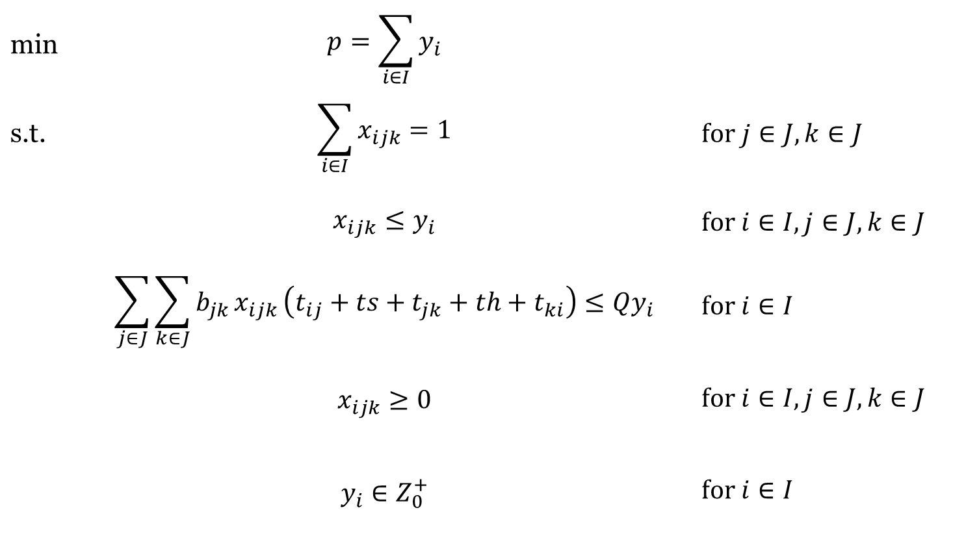
Model P1 – minimize the number of ambulances
min | $$p=\sum_{i∈I}{y_{i}}$$
s.t. | $$\sum_{i∈I}{x_{ijk}=1}$$ | $$\text{f}\text{or} j∈J,k∈J$$
 | $$x_{ijk}≤y_{i}$$ | $$\text{f}\text{or} i∈I,j∈J,k∈J$$
 | $$\sum_{j∈J}{{\sum_{k∈J}{b_{jk}}x}_{ijk}}\left(t_{ij}+ts+t_{jk}+th+t_{ki}\right)≤Qy_{i}$$ | $$\text{for} i∈I$$
 | $$x_{ijk}≥0$$ | $$\text{f}\text{or} i∈I,j∈J,k∈J$$
 | $$y_{i}∈Z_{0}^{+}$$ | $$\text{for} i∈I$$
10

Slide 11
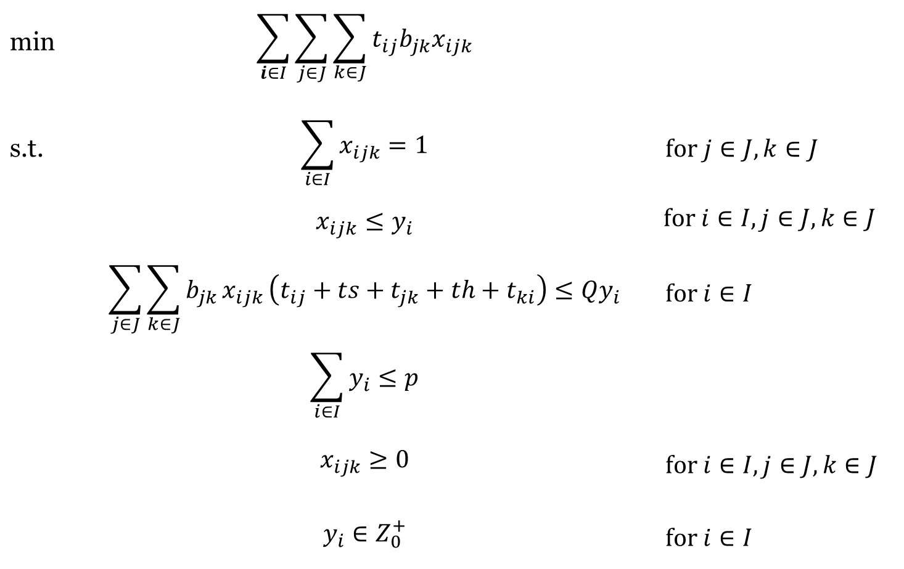
Model P2 – minimize travel time
min | $$\sum_{i∈I}{\sum_{j∈J}{\sum_{\begin{aligned}k∈J \\ \end{aligned}}{t_{ij}{b_{jk}x}_{ijk}}}}$$
s.t. | $$\sum_{i∈I}{x_{ijk}=1}$$ | $$\text{f}\text{or} j∈J,k∈J$$
 | $$x_{ijk}≤y_{i}$$ | $$\text{f}\text{or} i∈I,j∈J,k∈J$$
 | $$\sum_{j∈J}{{\sum_{k∈J}{b_{jk}}x}_{ijk}}\left(t_{ij}+ts+t_{jk}+th+t_{ki}\right)≤Qy_{i}$$ | $$\text{for} i∈I$$
 | $$\sum_{i∈I}{y_{i}≤p}$$
 | $$x_{ijk}≥0$$ | $$\text{f}\text{or} i∈I,j∈J,k∈J$$
 | $$y_{i}∈Z_{0}^{+}$$ | $$\text{for} i∈I$$
11

Slide 12
Simulation results for different number of transport ambulances
12

Slide 13
Conclusions
The minimum number of transport ambulances is 17.
All patients could be transported at
lower costs compared to the current system (47 emergency ambulances).
Thank you for your attention!
13

